Slide 1
Lock-Free Collaboration Support for Cloud Storage Services with Operation Inference and Transformation
Jian Chen, Minghao Zhao, and Zhenhua Li, Tinghua University;
Ennan Zhai, Alibaba Group;
Feng Qian, University of Minnesota;
Hongyi Chen, Tsinghua University;
Yunhao Liu, Tsinghua University and Michigan State University
Tianyin Xu, UIUC
USENIX FAST’20, Feb. 25th, Santa Clara, CA

Slide 2
How do you collaborate with your colleagues & teammates?
Emails & IM Apps
Dedicated Online Editors
Version Control Systems
traditional, easy-to-grasp
web-based, easy-to-use
fine-grained conflict resolution
low work efficiency
limited functions
complex instructions
cannot work concurrently
“walled-garden” concerns
not user-friendly

Slide 3
Collaboration with cloud storage services
main.tex
main (Alice’s conflicted copy 2019-12-21).tex
main (Alice’s conflicted copy 2019-12-21)(2).tex
① Automatic file update
② Check and Notify
③ Automatic propagation
main (Bob’s conflicted copy 2019-12-21).tex
main (Alice’s conflicted copy 2019-12-21) (Bob’s conflicted copy 2019-12-21).tex
The conflict issue
Notes:
As an emerging alternative approach, some cloud storage services, such as Dropbox, Onedrive and iCloud, provide an easy way for collaboration. After installing the client software of these services, the users will be designated a sync folder, and all the modifications in the sync folder will be automatically synced to the cloud. In the meantime, the client and the cloud periodically check the file status, and whenever a new version is found in the cloud, it will notify the file update to the client and then automatically propagate it to the sync folder of the collaborators.
When everything goes smooth, using Dropbox for collaborations is much easier than using Version Control Systems, since the users do not need to understand and manipulate the complex VCS primitives.
However, collaboration with cloud storage services will leads to conflicts. When conflicts happen, take Dropbox for example, a conflicting version will be generated and renamed, and then delivered to all the collaborators. In such cases, the collaborators have to manually fix the problem with considerable efforts. This work is even hard when the conflicts happen between multiple collaborators.

Slide 4








Undesired collaborative editing experiences
Conflicts despite coordination
Losing updates
Excessively long sync duration
Blocking collaborators by opening files
Notes:
What is even worse, the conflicts not only happen when collaborators simultaneously edit the same file. Instead, even if collaborators edit a file in a rigorous alternant manner, the conflict still happens, and this case exists in all the studied services.
Besides, we found some other undesired experiences resulting in or relating to collaboration conflicts, including losing updates, which happens in all the studied services, excessively long sync duration, which happens in Dropbox, OneDrive, Seafile, SugureSync and Dropbox, and blocking collaborators by opening files, which happens in Seafile.

Slide 5
The measurement study
How these happen; and
What we can do about it.
Data-Driven Method
Package Capturing
Traffic Decryption
Documents Reading
Source-code Reading
Features of conflicts
File update methods
File update methods
Message queue
Message queue
Sync delay
Sync delay
Lock status
Delta sync
Conflict resolution
Notes:
这一页东西很多，但是需要的语言并不多，这一页主要是给观众展示的。
To reveal the root cause of the undesired experiences, we conducted comprehensive experiments, including, data-driven simulation, package capturing, traffic decryption, reading documents and source codes.
With these efforts, we figure out multiple features in the aspects of collaborations (as listed in this slide), which will be detailed later.

Slide 6
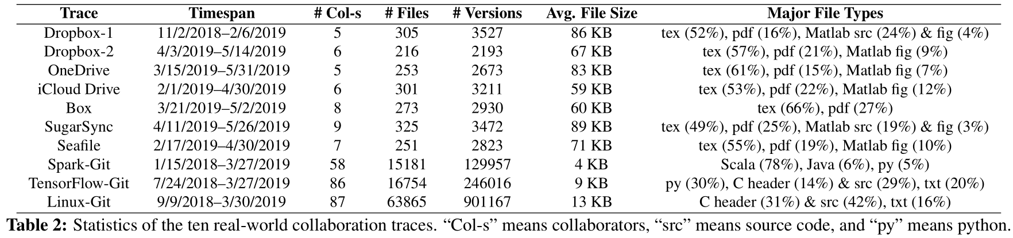
Data-driven analysis
We collected:
Seven cloud storage service-based collaboration datasets;
  Dropbox, OneDrive, iCloud Drive, Box, SugarSync, and Seafile
Three collaborative developed open-source projects.
  Spark, TensorFlow, and Linux
Replay with automatically controlled AWS virtual machines
Notes:
With these efforts, we figure out multiple features in the aspects of collaborations (as listed in this slide), which will be detailed later.
To be specific, in terms of data-driven replay, we first collect ten real-world collaboration traces. Among them, seven are provided by users that collaborate on code/document writing
using different cloud storage services, including Dropbox, OneDrive, iCloud Drive, Box, SugarSync, and Seafile; and the other three are extracted from
well-known open-source GitHub projects.
The detailed information is demonstrated in this table.
With these datasets, we deployed automatically controlled puppet collaborators at AWS virtual machines to replay the trace on eight mainstream cloud storage services. This enables us to know some key features of cloud storage-based collaborations in the real world, such as the collaboration workload, frequency of conflicts, and their conflict resolution strategies.

Slide 7
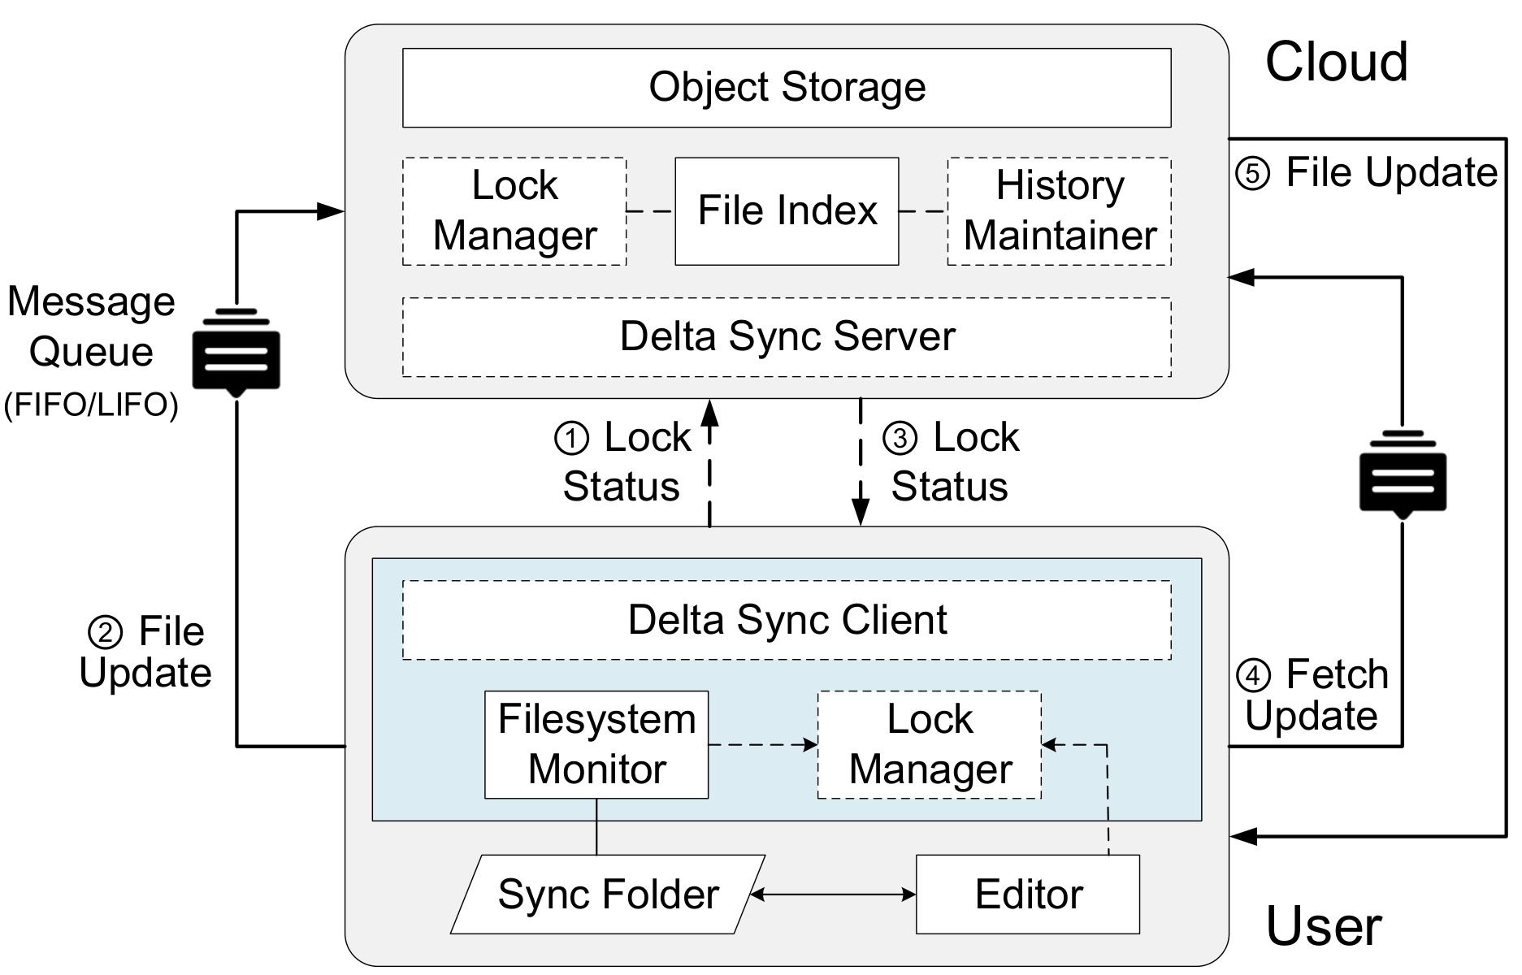
Package capturing, traffic decrypting, and docs & source reading
Capturing packages transmission with Wireshark
  Network transmission in all cloud storage services are encrypted with HTTPS
Cracking HTTPS by conducting man-in-the-middle attacks with Charles
  Succeeded with OneDrive, Box, and Seafile；
Reading official docs, developers’ docs, user manuals, and online blogs
Reading Seafile source code.
Notes:
In them other measurement experiments, we capture all the IP-level sync traffic in the trace-driven and benchmark experiments via Wireshark.
By analyzing the traffic size and occurrence time, we can understand the basic design of these eight mainstream cloud storage systems.
Besides, we observed that almost all the communications in these clouds storage services are encrypted through HTTPS. To future acquire their design details, we tried to crack the HTTPS sessions by conducting man-in-the-middle attacks with Charles and succeeded with OneDrive, Box, and Seafile, as the others refuse to accept the certificate forged by Charles.
In addition, we read various documents available online. also, as Seafile is open-sourced, we read the source code of it.
With these efforts, we also figure out the workflow and architectural designs of mainstream cloud storage services in relation to collaboration support, as demonstrated in this picture.

Slide 8
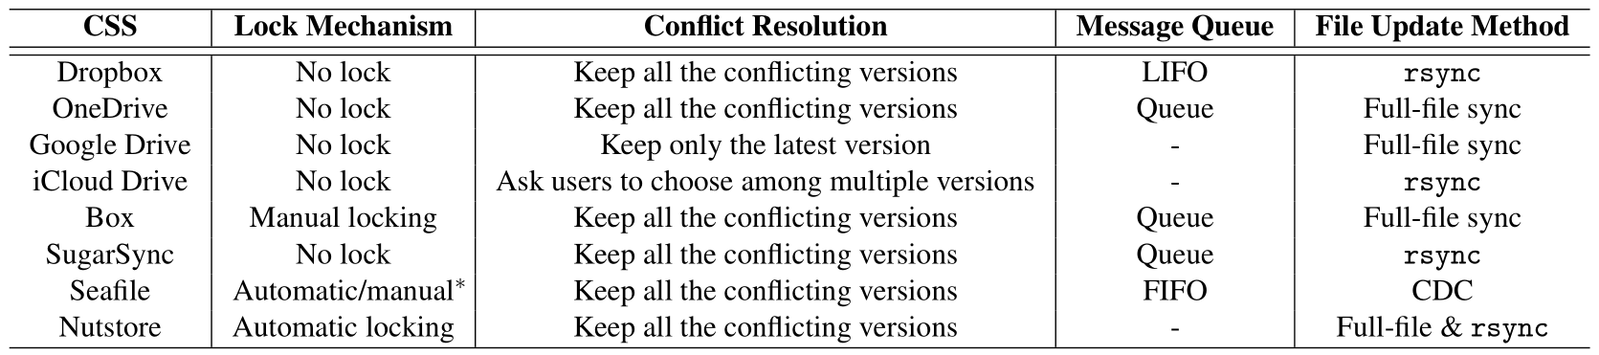
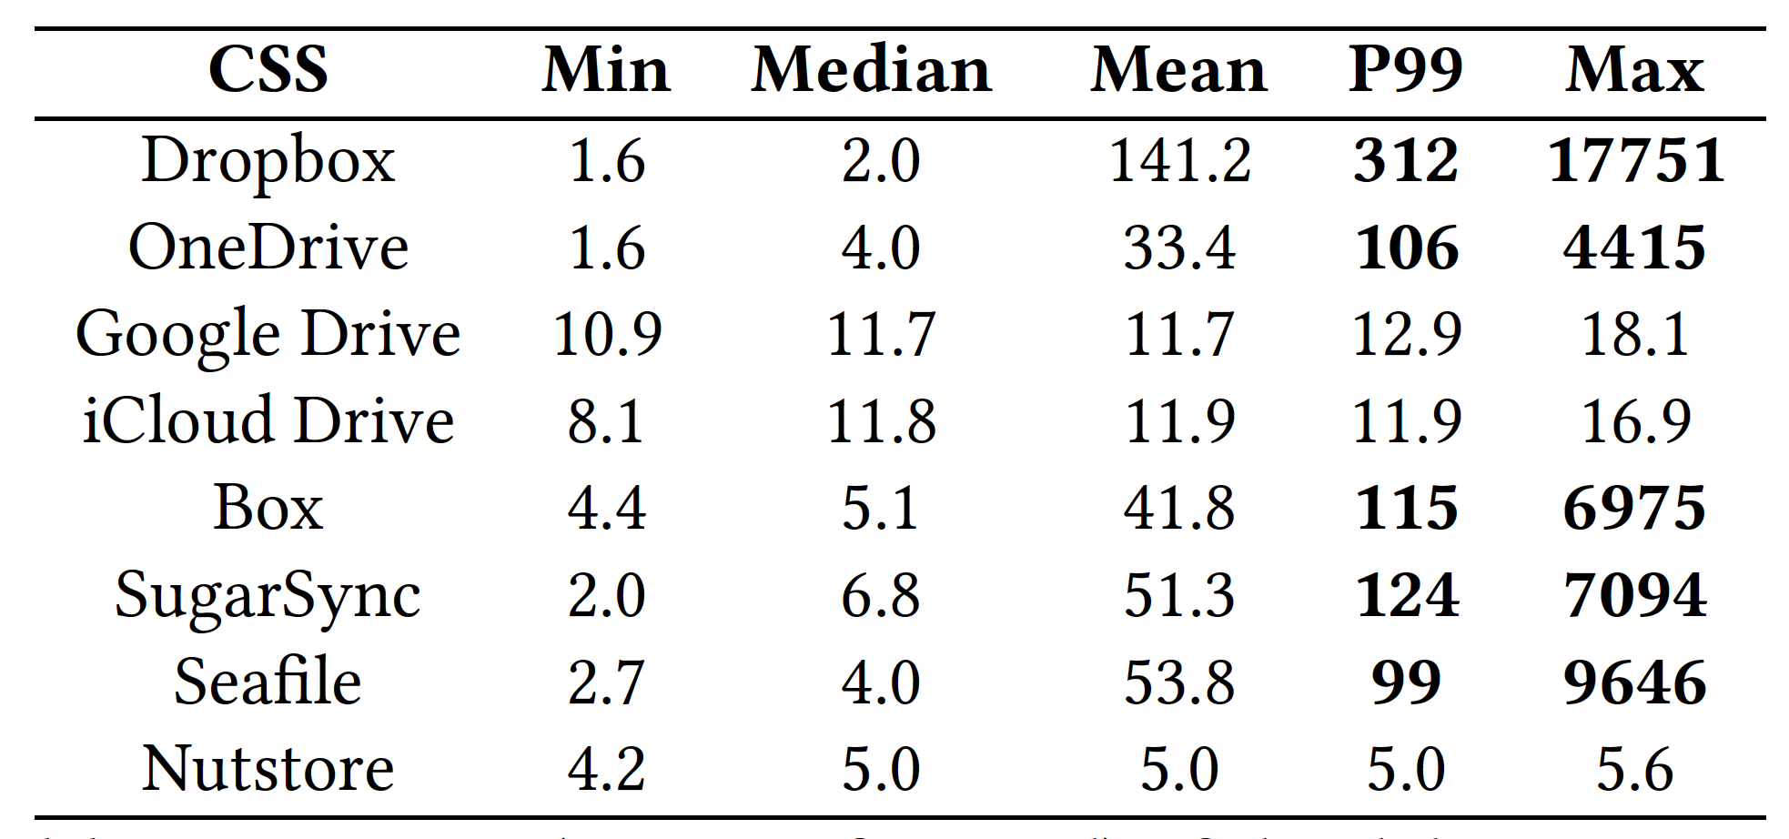
Major findings (1)
Long sync delay leads to conflict
Undesired using locks
  No locks
  Manual locks
  Automatic locks (too early or too late)
Notes:
这一页是重点，需要停留较长时间。加下来需要加注释
As the result of our measurement study, first, we find that the unpredictable long sync delay, especially the "long-tail effect”, leads to the conflict, and their adoption of massage queues make this situation more severe.
Also, toady's cloud storage services are unable to effectively or desirably prevent conflicts.
Specifically, some services do not use locks, which cannot prevent the happening of conflicts. Some use manual locks which are not user-friendly. Although some adopt automatically locks, they cannot edit a file at an ideal time, as the cloud storage services cannot monitor the users' editing behavior.

Slide 9
Major findings (2)
Unsatisfied conflict resolution strategies
  Last Write Win (LWW); Keep all; force users to choose
  File-level are too coarse-grained for conflict resolution
Most conflicts are false conflicts – edits made on different parts
Implications:
lock-free conflict prevention and fine-grained conflict resolution
Notes:
The resolution strategies used by cloud storage services are also unsatisfied.
They either only keep the latest version (also referred to as Last Write Win strategies), or keep all conflict versions and propagate them to all collaborators, or force users to choose one version to save.
This file-level conflict resolution is too coarse-grained for cloud storage services, as none of them are easy for the users to further manually fix conflicts.
Fortunately, we also find among these conflicts, a vast majority of them are false conflicts, which means the edits are made on the different parts of a file.
To sum up our findings, we deem that the conflicts in collaboration with cloud storage services are generally inevitable, existing lock-based conflict prevention is not desirable, and existing file-level conflict resolution is too coarse-grained. Thus, it is preferable to propose conflict prevention schemes without using locks and design fine-grained conflict resolution.

Slide 10
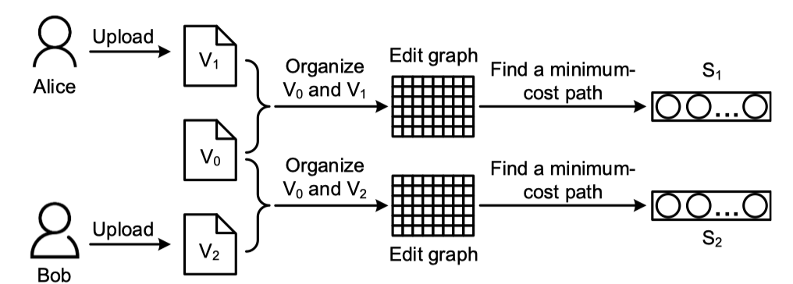
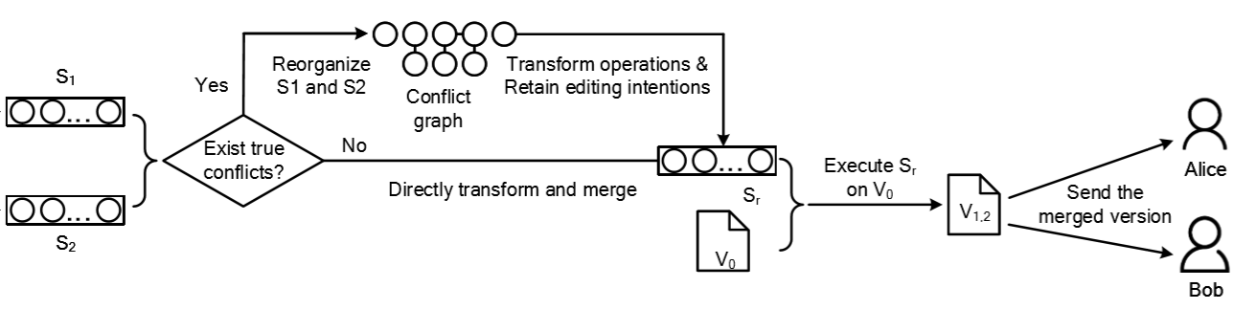
UFC2: User-Friendly Collaborative Cloud
1. Inferring operation sequences of the uploaded versions using edit graphs.
2. Transforming and merging operation sequences with the minimal conflicts.
3. Executing the merged operation sequence on the base version to generate a final merged version.
Notes:
To accomplish this goal, we design the UCF2, the User-Friendly Collaborative Cloud, which achieves lock-free conflict prevention and fine-grained conflict resolution.
Our key idea is to model file editing events as insert or delete operations, we design intelligent approaches to the inference and transformation of users’ editing operations, as well as optimizations to the maintenance of files’ historic versions.
Here is a demonstration of working principle for merging two versions of the same file at the cloud side.
In the first step….
in the second step…..
and finally…….
We will detailly describe each procedure later.

Slide 11
Inference (implicit) operation sequences (1)
Finding the Shortest Edit Script (SES)
Input: V₀ and V₁
Output: operation sequence S₁ that changes V₀ to V₁
Calculating the longest common substring (LCS) of V₀ and V₁ using DP
V₀+LCS→Operation sequence of Delete
LCS+V₁→Operation sequence of Insert
Combine the Delete and Insert sequences
LCS with Dynamic Programming (DP) – A traditional method
Complexity: O(n₀*n₁)
(n₀ and n₁ are the length of V₀ and V₁, respectively).
30 second for handling text files with size of 500 KB
Notes:
Complexity: O(n0*n1), in which n0 and n1 are the length of V0 and V1, respectively.
Finding the Shortest Edit Script (SES)
– Representing the procedure of changing one sting to another one with two operations (i.e., insert and delete)

Slide 12
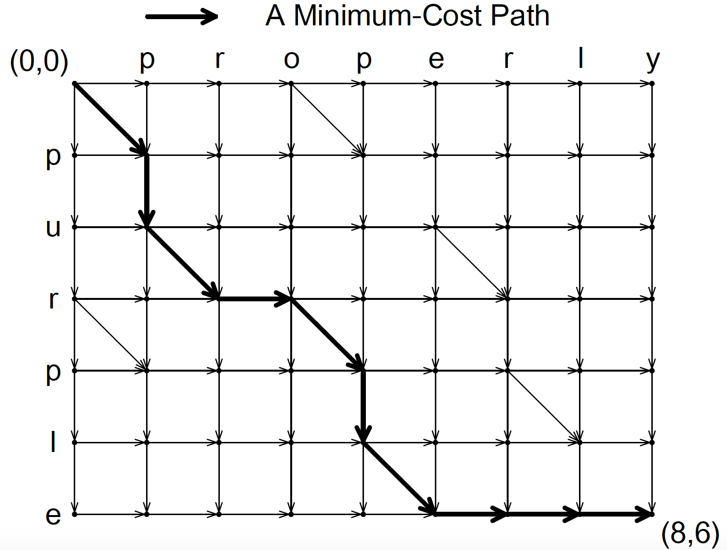
Inference (implicit) operation sequences (2)
Input: V₀ and V₁
Output: operation sequence S₁ that changes V₀ to V₁
Myers Diff – the edit graph-based approach
A horizontal/vertical edge is given weight 1;
A diagonal edge is given weight 0;
Finding a minimum-cost path that goes from the start point to the end point;
Efficiently solved with greedy algorithms.
Complexity: O((n₀+n₁)*d), in which d is the deference between V₀ and V₁.
200 ms for files of 500KB in size.

Slide 13
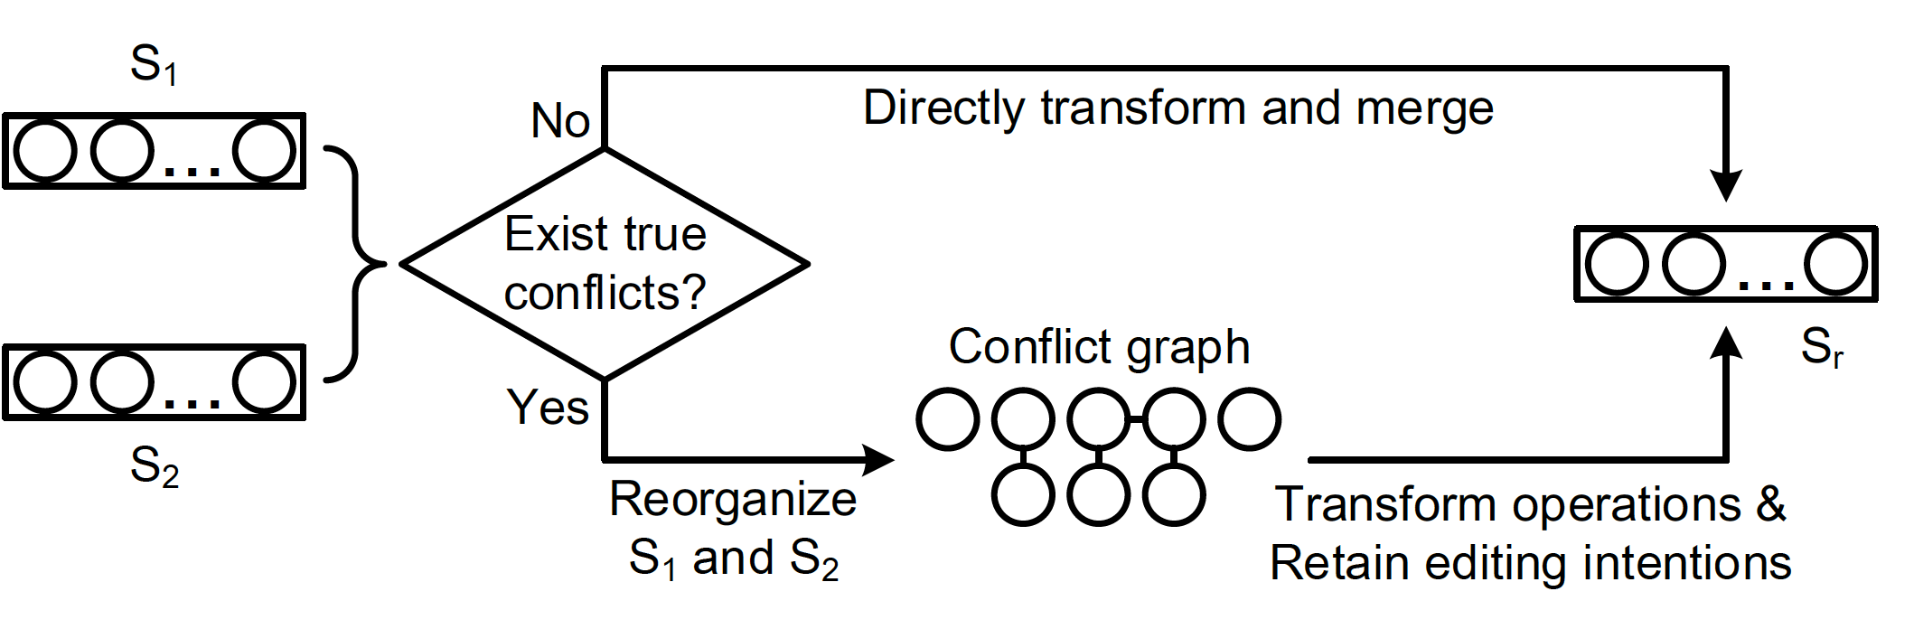
Automatic detecting true conflicts
Merging operation sequences
Input: S₁ and S₂
Output: S_{r}
True conflicts detection:
Sort all operations in S1 and S2 as ascending order;
Check whether any operation conflicts with the one behind it (i.e., whether their impact ranges overlap each other.)
Complexity: O(s₁+s₂)

Slide 14
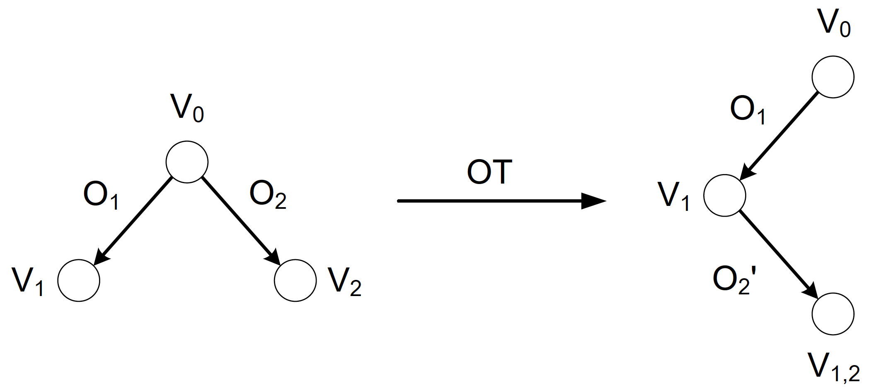
Automatic resolution of false conflicts
Merging operation sequences
Input: S₁ and S₂
Output: S_{r}
Automatic conflict resolution when there are no true conflicts.
Directly transform all operations in S1 and S2
V₀: ABC
O₁ : Add X at position 1 (AXBC)
O₂: Add Y at position 2 (ABYC)
V₁: AXBC
O₂’: Add Y at position 3 of V1 (AXBYC)
Complexity: O(s₁+s₂)

Slide 15
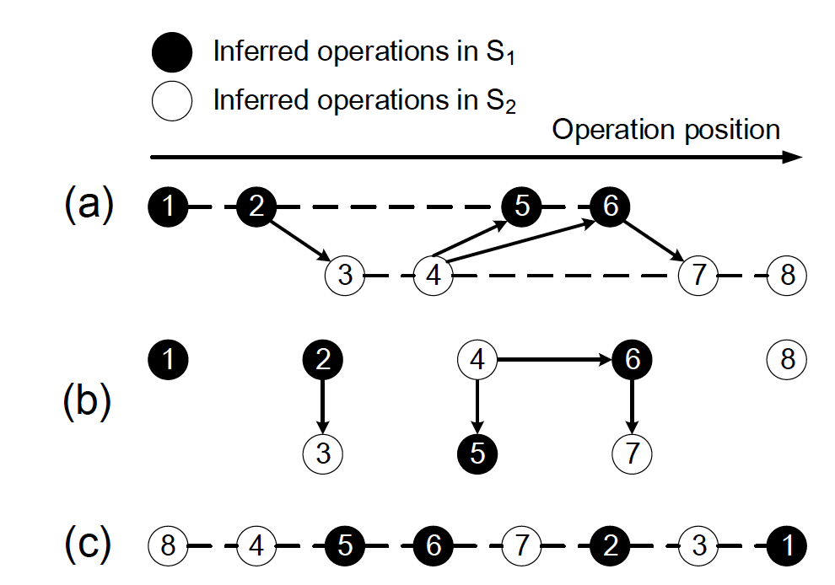
Desirable conflict resolution for true conflicts
Merging operation sequences
Input: S₁ and S₂
Output: S_{r}
Two principles:
Send merged version for conflict resolution
Retain users‘ edit intentions as much as possible
Reorder conflicting operations with a conflict graph
Topological sorting in the conflict graph
Merge the topological sorted operations with customized OT and generate S_{r}
Complexity: O(s₁+s₂)

Slide 16
Customized OT preserving users’ edit intentions
Three true conflict types
delete < delete
delete < insert
insert < delete (not true conflicts )
insert < insert
A delete operation appears before another delete operation and they overlap each other.
“delete < delete” conflict
V₀ = We need foods, water, clothes, and books.
O₁ = We need foods, water, clothes, and books.
O₂ = We need foods, water, clothes, and books.
V_{1,2}=We need [Alice delete: foods,] [Bob delete: clothes,] and books.
Notes:
we identify three types of true conflict

Slide 17
Customized OT preserving users’ edit intentions
“delete < insert” conflict
V₀ = There is a cat in the courtyard.
O₁ = There is a cat in the courtyard.
O₂ = There is a cat in the spacious courtyard.
V_{1,2}=There is a cat [Alice delete: in the ][Bob insert: spacious ][Alice delete: courtyard].
“insert < insert” conflict
V₀ = We need foods and books.
O₁ = We need foods, water and books.
O₂ = We need foods, clothes and books.
V_{1,2}= We need foods, [Alice insert: , water][Bob insert:, clothes] and books.”

Slide 18
Handling multiple conflicting versions
(a) Operation inference
(b) Operation transformation
Inferring operation sequences of each version
  generating S₁, S₂, … ,S_{n};
Merging operation sequences one by one with the operations transformation method
  generating S_{r1,….,n}
Executing S_{r1,….,n} on the base version
(c) Operation inference

Slide 19
Implementation and Evaluation https://ufc2.github.io/
UFC2 (User-Friendly Collaborative Cloud)
5000 lines of Python code
Deployed at Amazon AWS (S3+EFS)
Compatible with mainstream cloud storage architecture

Slide 20
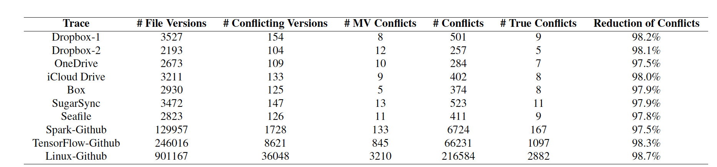
Effectiveness of conflict resolution
The conflict rate is about 4%.
Among these conflicts, a very small proportion of them are true conflicts
Effectively solved 98% of the conflicts.
Notes:
这一页只需讲一句话——
Our system effectively solved 98% of the false conflict; and for the rest, with our hinds, it is easy for the users to manually fix them.

Slide 21
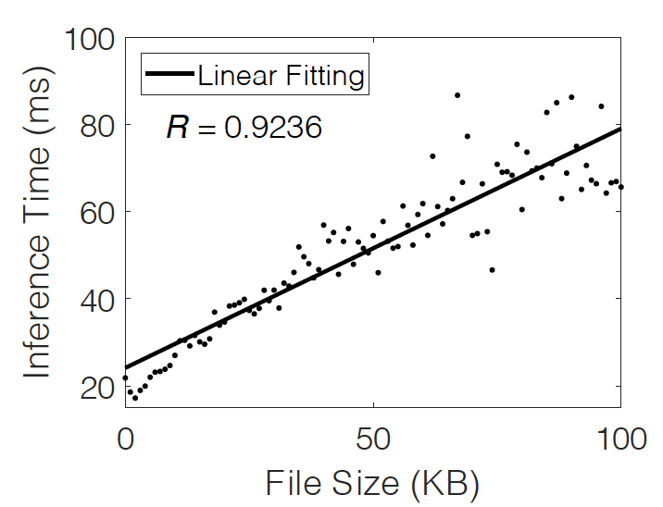
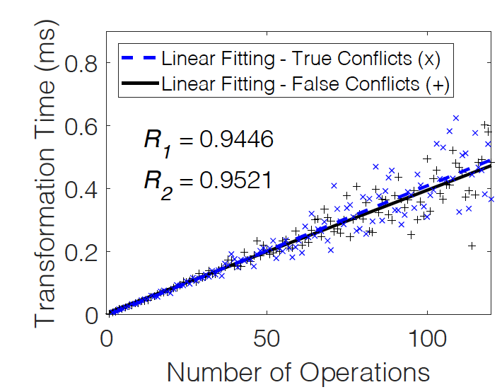
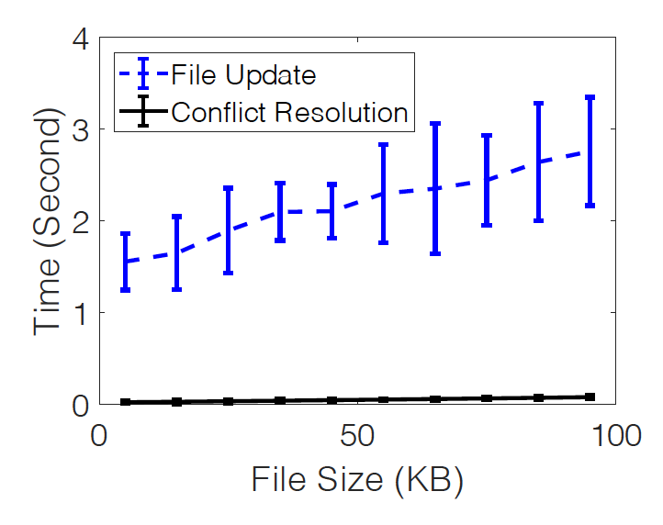
Overhead in conflict resolution
Time overheads of operation inference and transformation are linear to the file size and number of operations, respectively.
The time overhead of conflict resolution is merely 2% of the time in delivering an update.

Slide 22
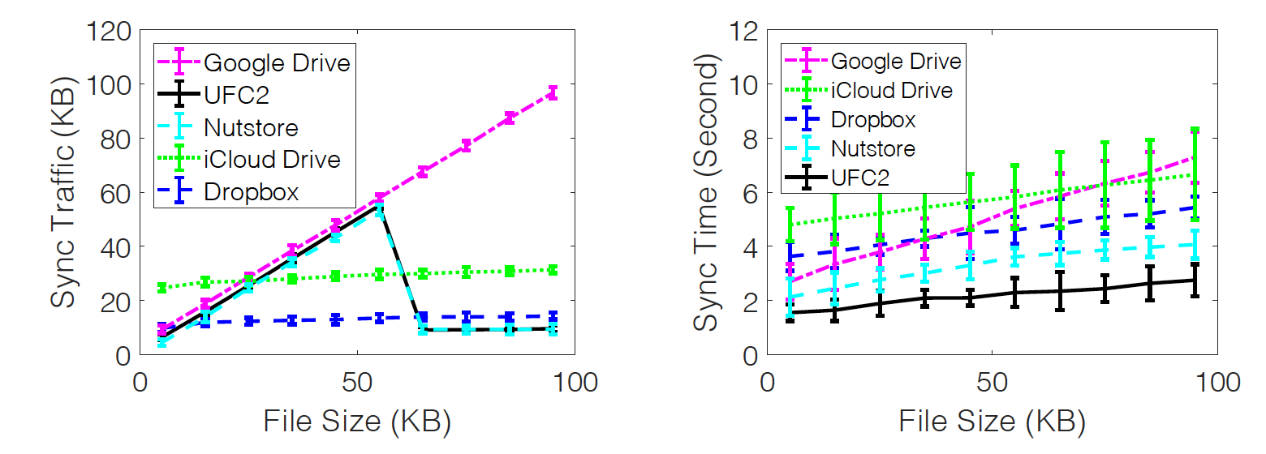
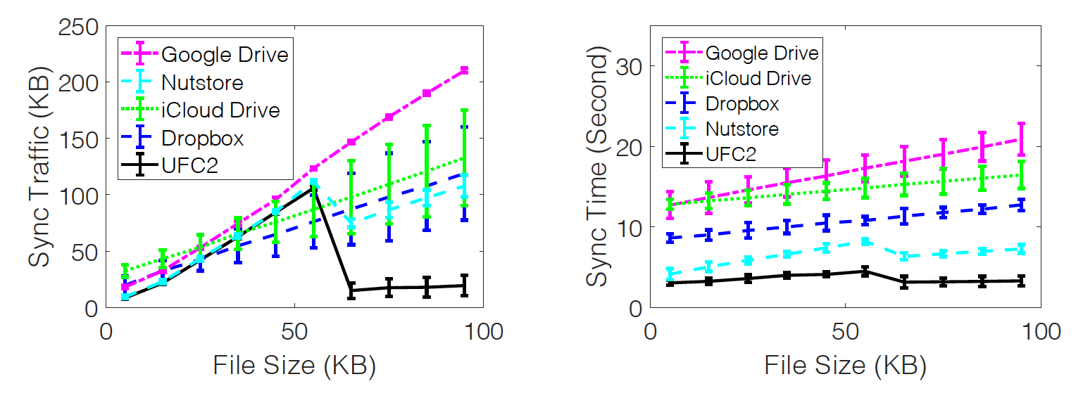
Overhead in network traffic
No true conflicts
UFC2 consumes less sync traffic and requires least time for syncing in both cases.
True conflicts exist
The turning point of full-file sync and delta sync

Slide 23
In summary
Collaboration with cloud storage services
  Easy-to-use and automatic sync
  Inevitable (false) conflicts
Ineffective/undesirable conflict prevention and resolution methods
UFC2: lock-free, operation-based and fine-grained conflict resolution
Code and data: https://ufc2.github.io/
Contact us: mh-zhao17@mails.tsinghua.edu.cn; lizhenhua1983@tsinghua.edu.cn

